Slide 1
Intro to Pollination Ecology
Lecture 1, Kate Borchardt
Notes:
Hi I am kate Borchardt and this is my introduction to pollination ecology seminar course! This is my first time developing my own class and teaching, so I hope that y’all bear with me with any kinks with this seminar. But I do hope that from this course you get a well-rounded education on pollination ecology, pollination research, and what you can do as a scientist in this field.

Slide 2
Main Ideas:
Instructor Introduction
Student introductions
Course Structure
Schedule and topics
Student project
Introduction to Pollination:
Wind and water pollination release large amounts of pollen into the environment in the hopes some fertilize a receptive female flower of the same species.
Animal-mediated pollination is when plants attract other organisms to their flowers to carry pollen between flowers and/or individual plants.
Pollination is important for the persistence of wild plant populations and agricultural production.
There is a potential for conflict of interests between plants and pollinators because they want different things from the mutualism.
Notes:
Wind pollination is best known as the main pollination method for grasses. The key traits of wind pollinated flowers are that they are inconspicuous, have no scents or nectar, produce light, dry pollen with low nutritional content – just what iis needed for reproduction. Here you can see a rice flower, which looks very different than what we traditionally think of as a flower. It has the male stamen with anthers producing pollen and the female carpel. There are no petals or corolla, only modified stems to protect the reproductive organs. So the “showy” parts of the flowers are greatly diminished because the flowers are using a strategy of releasing a ton of “cheaply made” pollen into the environment and hoping for the best.

Slide 3

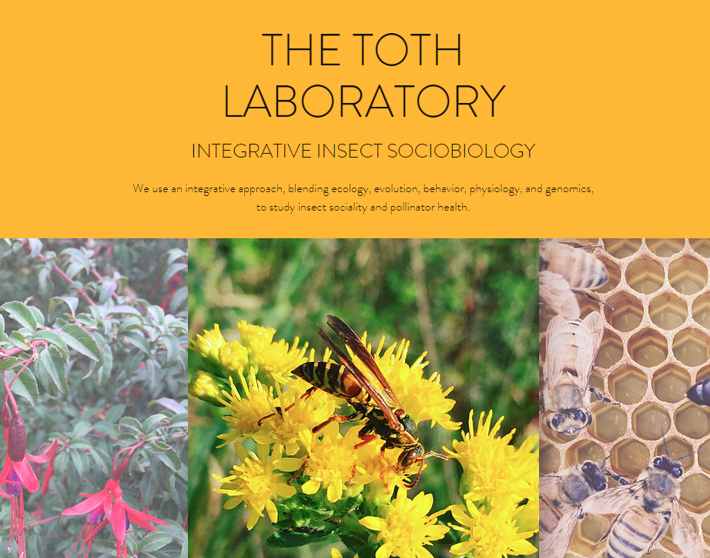
About Me: Kate Borchardt
2014 – Freshman at University of California Davis
2015 – Started working in Neal Williams’ Pollination Ecology Lab
2018 – Graduated with a BS in Evolution, Ecology, & Biodiversity (EEB) and a minor in German Language
2019 – Started as a PhD Student at Iowa State University in Amy Toth’s Lab (EEB/EEOB)
2021 – Passed Preliminary Exams and became a PhD Candidate
Future Goals: Become a Professor and have a research lab
Notes:
First I want to start off with an introduction about me. I entered undergraduate college in fall of 2014 at University of California Davis as a biology major, trying to figure out what I wanted to do with my life. During my introduction to biology course, I became really interested in ecology and specifically with looking at interactions between species and within an entire ecosystem. I felt like I might want to be a scientist and researcher, so I joined the Williams’ lab as a laboratory assistant studying pollination ecology and I fell in love with the field. I switched my major to Evolution, Ecology, and Biodiversity and graduated in 2018. I really wanted to go to graduate school for my PhD directly out of undergrad, but it wasn’t meant to be. I was lucky to continue working full-time in Williams’ lab during my gap year, and I started as a PhD Student at Iowa State in 2019 working in Amy Toth’s lab studying pollination networks. At the end of spring semester 2021, I passed my preliminary exams to become a PhD Candidate. Just wanted to say that because I’m happy I passed. My future goals are to become a professor and have a research lab to mentor and encourage young people to pursue a career in science and research, which is also why I decided to put this course together.

Slide 4
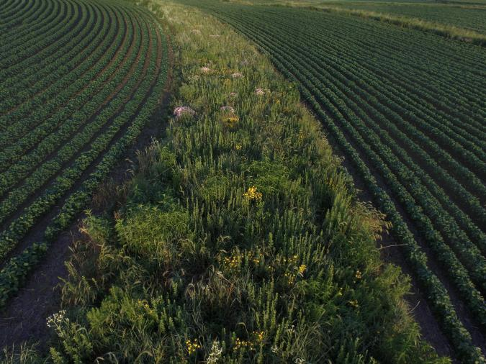
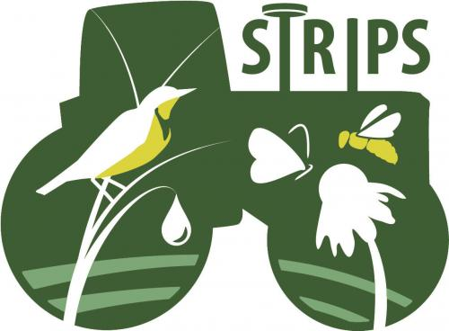
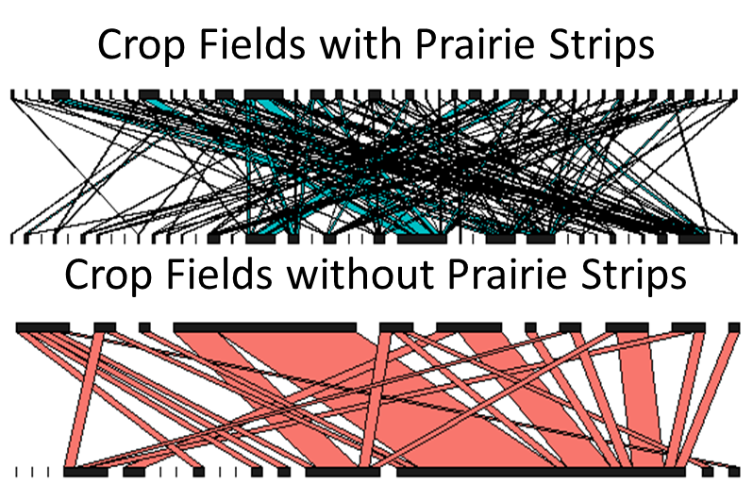
About Me: Pollination Networks
Notes:
In Williams’ lab, I did an independent research project looking at how community context more specifically with if traits of neighboring plants influenced how many bees or which bees visited a specific plant individual, and this is just a visual I had of all the different traits we looked at that we thought could’ve had an effect. After that research, I wanted to continue looking at the larger ecosystem, so I started studying interaction networks. I work with the STRIPS program here at ISU which plants native prairie plant communities in corn and soybean fields to improve water quality and soil retention which farmers highly support, while also providing habitat for native organisms. The larger project focuses on monarch butterflies, honey bees, native bees, small mammals, lizards and snakes, and birds and I just focus on the native bee side of the project. Here you can see some networks from my first research project just comparing crop fields with prairie strips to crop fields without native habitat features and you can see the differences in complexity between the networks. And we will talk about community context and network research in pollination networks because naturally I think it is the coolest part of pollination ecology research, but this is just to introduce you to what I more specifically study for my PhD.

Slide 5
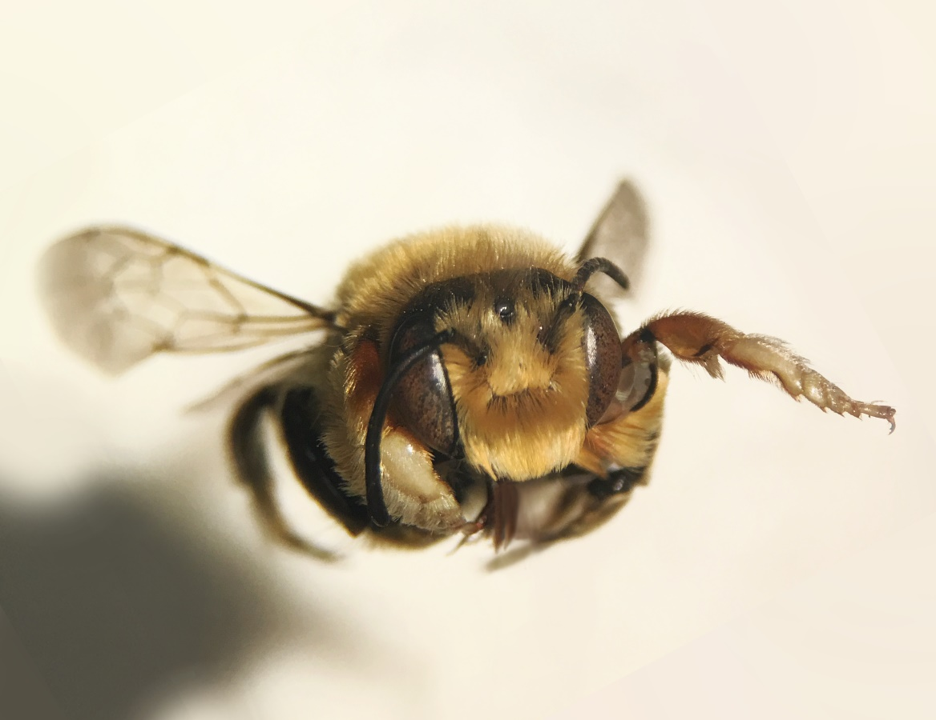
Structure of the course
Lecture Schedule
Introduction to Pollination Ecology
Plant Diversity & Strategies
Pollinator Groups
Bee Diversity
Social Bee Structure
Student Project – Topic Presentations
Cheating in Pollination Mutualism
Foraging Theory
Generalists & Specialists
Community Context
Interaction Networks
Student Project – Draft Article Peer Review
Pollination Research Methods
Pollinator Declines and Threats
Integrating Pollinators in a Changing World
FINALS WEEK – Submit Final Article
Notes:
Include meeting time, place, office hours, email
Summary of lecture topics and dates
Information on the written project if I have one
Weekly studies – going through a pollination study each week

Slide 6
Student Project
Students will write a short (2,000 words) literature review or opinion piece relating to a topic in pollination ecology and their field of study.
Literature Review: a survey of scholarly sources related to a specific topic or research question
Examples: Designing pollination drones, pollinator conservation in agriculture, etc
Opinion Piece: similar to a literature review, but focusing more on persuading the audience and using scholarly sources to support a particular argument.
Examples: reduction of pesticides in agriculture, including lesser known pollinators in pollinator management schemes
Important Dates:
____ - Create a short presentation (5-10 minutes) on your preliminary topic for the class, to get feedback on the idea.
____ - Bring copies of your draft article to class for peer review and feedback. You will review and comment on three of your classmates’ articles.
_____ - Due date for the final article.
Notes:
Include meeting time, place, office hours, email
Summary of lecture topics and dates
Information on the written project if I have one
Weekly studies – going through a pollination study each week

Slide 7
Student Introductions
Name, Major, Why you chose this course

Slide 8
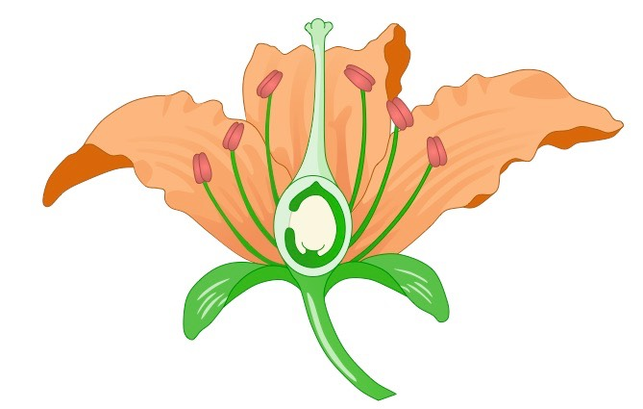
What is pollination?
Notes:
Now let’s go into a brief introduction to pollination. What is pollination? It is the method by which flowering plants known as angiosperms reproduce. It is meant as a method for sexual reproduction, although it can be used to asexually reproduce by self pollination, which we will get into later.

Slide 9
Basic Flower Anatomy:
stigma
anther
style
Carpel ♀
Stamen ♂
pollen grain
ovule
filament
nectary
corolla
sepals
Notes:
Before I go into the main process of pollination in plants, I will define the basic elements of plant anatomy, which we will revisit again next week when we go further into plant diversity. The male parts of the flower are collectively called the “stamen” and include the anther which houses pollen which stands at the end of the filament, which attaches to the base of the flower. The female parts of the flower are collectively called the “carpel” which includes the stigma on top of the style with the ovules typically at the base. Other key parts to know is the corolla, which is the collective term for the petals and the sepals which are the collective term for more leaf-like parts underneath the corolla, although occasionally these can be showy too. Flowers that produce nectar typically have nectaries or nectary tissue near the base of the flower, producing a small reservoir of nectar

Slide 10
Pollination Overview
Notes:
Sexual reproduction occurs when pollen travels from one flower to another flower’s stigmatic surface, here depicted as traveling on a bee. If the pollen grain is accepted by the stigma, it will grow a pollen tube down the style to the ovary where two sperm will fertilize the embryo and endosperm, which will develop into the seed.

Slide 11
Methods of Pollination
Three main types of pollination:
Wind
Water
Animal-mediated
Passive methods
Active method
Notes:
There are three main methods that plants use to transfer pollen between flowers: wind, water, and animal-mediated. Wind and water are considered “passive” pollination because they rely on abiotic factors to move their pollen from one place to another. Animal-mediated pollination is considered “active” pollination because it requires the active contribution of an additional organism: the pollinator.

Slide 12
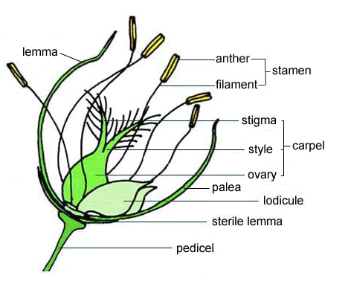
Methods of Pollination: Wind
Main pollination method for grasses
Key traits:
Inconspicuous flowers^{1,2}
No scents or nectar^{1,2}
Light, dry pollen^{1,2}
Low nutritional content (bare minimum for reproduction)¹
“feathery” stigma to catch pollen²
Strategy:
Create a lot of pollen to set adrift in the wind in hopes that some reach a receptive female flower of the same species.
¹Division of Agriculture and Natural Resources (2020) “Wind”. University of California, Pollen Nation [Internet]. Available at: https://ucanr.edu/sites/PollenNation/Meet_The_Pollinators/Wind/
²US Forest Service. “Wind and Water Pollination”. USDA, Washington DC [Internet]. Available at: https://www.fs.fed.us/wildflowers/pollinators/wind.shtml
[image] Rost, Thomas L. (1997) “Rice Flower Anatomy”. University of California Davis [internet]. Available at: http://www-plb.ucdavis.edu/labs/rost/Rice/reproduction/flower/flower.html
Notes:
Wind pollination is best known as the main pollination method for grasses. The key traits of wind pollinated flowers are that they are inconspicuous, have no scents or nectar, produce light, dry pollen with low nutritional content – just what iis needed for reproduction. Here you can see a rice flower, which looks very different than what we traditionally think of as a flower. It has the male stamen with anthers producing pollen and the female carpel. There are no petals or corolla, only modified stems to protect the reproductive organs. So the “showy” parts of the flowers are greatly diminished because the flowers are using a strategy of releasing a ton of “cheaply made” pollen into the environment and hoping for the best.

Slide 13
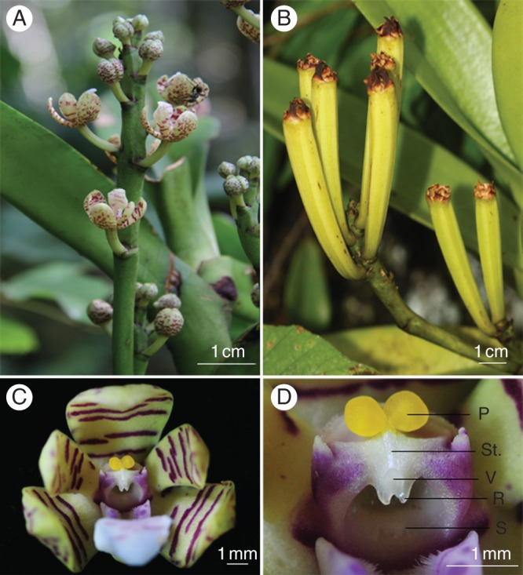
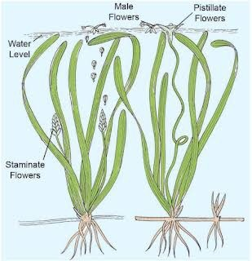
Methods of Pollination: Water
Used mostly by underwater plants (surface hydrophily) but has been found in terrestrial species (ombrophily).
Surface Hydrophily Traits (2% of plants)3:
Produces lots of pollen¹
Pollen floats to female flowers on the water’s surface³
Unisexual flowers³
Stigma modified to catch pollen (web-like, sticky, etc)¹
Rain Pollination (Ombrophily) Traits:
Lots of pollen²
Slick petal surface²
Dome shape to rebound rain²
¹Hoyt, Richard (2017) “Water-Pollinated Plants” Sciencing, Leaf Group Media [Internet] Available at: https://sciencing.com/water-pollinated-plants-13428273.html
²Fan, Xu-Li et al (2012) Rain Pollination provides reproductive assurance in a deceptive orchid. Annals of Botany 110 (5): 953-958.
³US Forest Service. “Wind and Water Pollination”. USDA, Washington DC [Internet]. Available at: https://www.fs.fed.us/wildflowers/pollinators/wind.shtml
[image] (2020) “What is water pollination”. Quora [internet]. Available at: https://www.quora.com/What-is-water-pollination
Notes:
A rarer method of pollination is water pollination. It is mostly used by underwater plants in a method called surface hydrophily, where the male staminate flowers float to the surface and produce pollen grains set adrift to female pistillate flowers also on the surface which catch the floating pollen grains. Therefore, these flowers produce a lot of pollen like wind pollinated plants, have unisexual flowers, and have a modified stigma to catch pollen that could be web-like or have a sticky substance. Another type of water pollination uses rain and has been found in some terrestrial plants such as * orchids. These plants can also be animal-pollinated and use rain pollination as a “backup” plan so to speak. These flowers produce a lot of pollen and have a corolla of petals with a slick surface shaped like a dome to rebound rain drops within the same flower, to move pollen from the anthers to the stigma for self pollination.

Slide 14
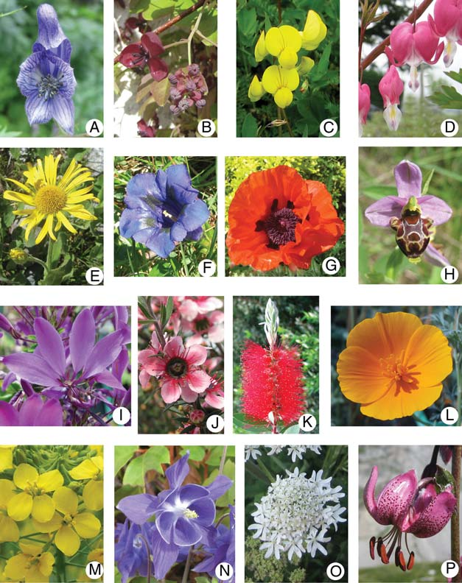
Methods of Pollination: Animal-Mediated
Most well-known method of pollination.
Key Traits:
Showy corolla, scents
Produces nectar as floral reward
Nutritious pollen or extra “sterile” pollen
There are many pollinating organisms:
Bees
Butterflies
Birds
Beetles
Flies
Moths
Wasps
Small mammals (including bats)
[image] Damerval, C., A. Becker, & K. Alix. (2011) The evolution of flower development: current understanding and future challenges. Annals of Botany 107: 10.1093/aob/mcr122.
Notes:
By far the most well known method of pollination is animal-mediated pollination, which will be the main focus of this course. These flowers are “showy” with bright colors and scents, they produce nectar as a “floral reward” with high sugar content, and offer nutritious pollen or sometimes excess sterile pollen for pollinators to consume as well. This picture shows the diversity of appearance of these flowers, with many different strategies to attract pollinating organisms, of which there are many more than what are often portrayed. The most well known are bees, butterflies and birds, but also beetles, flies, moths, wasps, and small mammals including bats can pollinate different plant species. Additionally, we are learning new pollinator relationships all the time and the importance of each of these pollinating organisms is constantly changing, which we will learn about in later lectures.

Slide 15
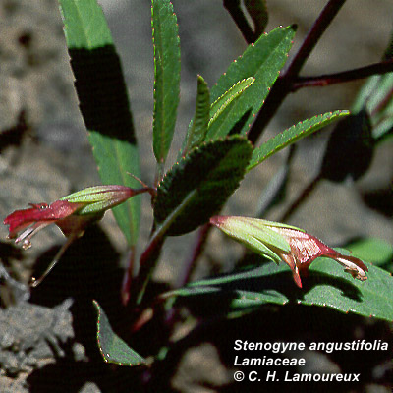
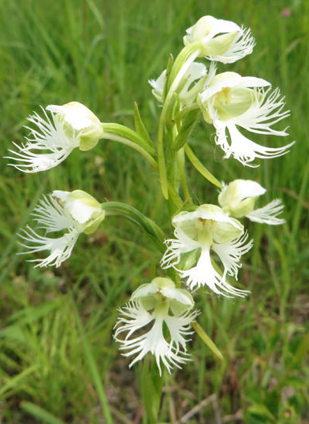
Importance of Pollination: Natural Habitat
Pollination maintains plant community composition, which is harmed when either pollinators or plant species become too rare for adequate pollination.
Hawaiian mint Stenogyne angustifolia:
Has no native pollinators left, is only rarely visited by 2 non-native bee species¹
Plant conservation projects have focused on hand-pollination when plant populations become too rare for animal-mediated pollination²
¹Aslan, Clare E., Christina T. Liang, Aaron B. Shiels, & William Haines (2018) Absence of native flower visitors for the endangered Hawaiian mint Stenogyne angustifolia: Impending ecological extinction? Global Ecology and Conservation 166: e00468.
² [bottom image] Krall, Ken (2019) Pollinating a rare plant species by hand pays off. WXPR [internet] https://www.wxpr.org/post/pollinating-rare-plant-species-hand-pays#stream/0
Notes:
But there are more concerns than just agricultural production and human health, pollinators are crucial for the maintenance of natural habitats. Pollination maintains plant community composition, which is harmed when either pollinator or plant species become too rare for pollination to occur. The most well-known example is a Hawaiian mint shown in the top image, which has no known native pollinators remaining and in one study was only visited by two non-native bee species across an entire year. The conservation program for this endangered species is to hand-pollinate flowers every year to keep it from going extinct. Other conservation programs use hand pollination to conserve species as well when the plant populations are too low and spread out for pollination to adequately occur, in order to produce seeds to increase the population.

Slide 16
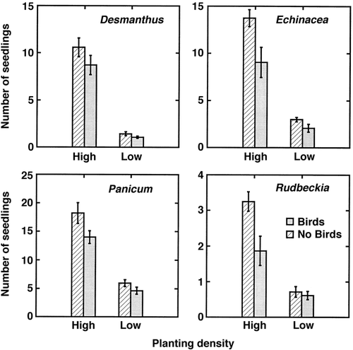
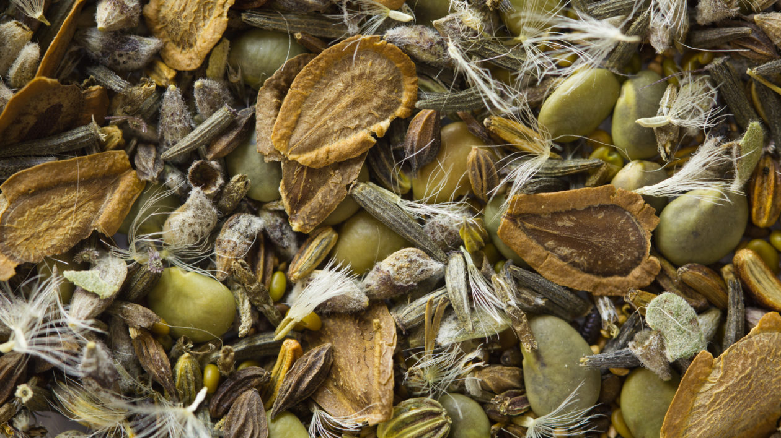
Importance of Pollination: Natural Habitat
Seed production is also important for granivores and higher tropic levels in the food web^{1,2}
© Justin Meissen
¹Pellish, Carmen A., et al (2017) Small vertebrate granivores reduce seedling emergence in native tallgrass prairie restoration. Restoration Ecology 26(2): 323-330.
²Howe, H. F. & J. S. Brown (1999) Effects of birds and rodents on synthetic tallgrass communities. Ecology 80(5): 1776-1781.
Notes:
And people who know about perennial plants and asexual reproduction in Iowa’s tallgrass prairies, pollination isn’t just important for plant community composition but also as a key part of the broader food web. Many organisms consume plant seeds such as rodents, small mammals, and birds, making successful pollination producing seeds vital to the conservation of these higher tropic levels as well. Here are some graphs from a prairie restoration study showing that presence of birds in newly established prairie had lower seedling emergence due to seed predation by bird species. Therefore even in prairie communities, where plants have other means of increasing their population other than through seed production, seed abundance is crucial to the maintenance of other tropic levels.

Slide 17
Importance of Pollination: Agriculture
Wind pollinated crops:
wheat, rice, corn, rye, barley, oats, walnuts, pecans, & pistachios¹
Animal pollinated crops:
35% of the world’s food crop production^{3,5} and 75% of crop species⁴
Tomatoes, strawberries, watermelon, squash, almonds, celery, sunflower seeds, etc
“Pollinators are responsible for 1 out of every 3 bites of food you eat!”²
¹Division of Agriculture and Natural Resources (2020) “Wind”. University of California, Pollen Nation [Internet]. Available at: https://ucanr.edu/sites/PollenNation/Meet_The_Pollinators/Wind/
²US Forest Service. “Animal Pollination”. USDA, Washington DC [internet]. Available at: https://www.fs.fed.us/wildflowers/pollinators/animals/index.shtml
³Natural Resources Conservation Service. “Insects & Pollinators”. USDA, Washington DC [Internet]. Available at: https://www.nrcs.usda.gov/wps/portal/nrcs/main/national/plantsanimals/pollinate/
⁴Bartomeus, I, et al. (2014) Contribution of insect pollinators to crop yield and quality varies with agricultural intensification. Peerj: 10.7716/peerj.328.
⁵ Klein, Alexandra-Maria, et al (2006) Importance of pollinators in changing landscapes for world crops. Proc. R. Soc. B. 274: 303-313.
Notes:
So why should we care? One reason is because pollination is important for the production of many food crops. Although many staple crops providing many calories like wheat, rice, and corn are wind pollinated, 35% of the world’s food crop production is reliant on animal pollination, including a lot of the food that many believe make diets more enjoyable like fruits, vegetables, some nuts, and other crops. That equates to about 1/3 bites of food you eat are reliant on animal pollination.

Slide 18
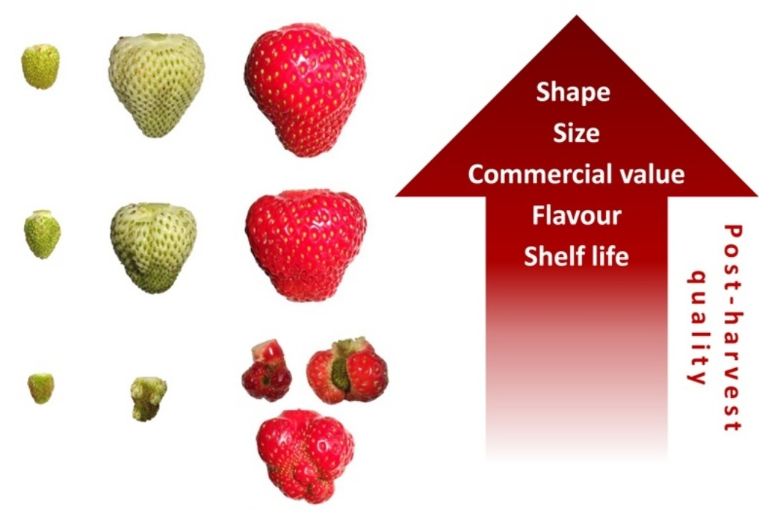
Importance of Pollination: Agriculture
Insufficient pollination produces low crop quality and yield¹
¹Wietzke, Alexander et al. (2018) Insect pollination as a key factor for strawberry physiology and marketable fruit quality. Agriculture, Ecosystems, & Environment 285: 197-204.
Notes:
After our lecture we will read this article in further detail, but basically sufficient pollination is required to produce sellable crops in many cases, here with strawberries what we consider “one fruit” is actually a conglomeration of multiple fruits and seeds, each of which need to be pollinated to produce an attractive fruit. The bottom strawberries are less pollinated, and therefore more deformed than the strawberries on the top, showing the importance of pollination in crop yield.

Slide 19
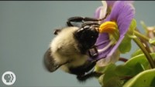
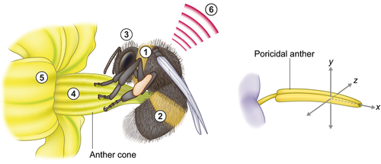
Importance of Pollination: Agriculture
Some crops require unique pollination from specific pollinator species¹
¹Vallejo-Marin, Mario (2018) Buzz pollination: studying bee vibrations on flowers. New Phytologist 224(3): 1068-1074.
Notes:
Some crops even require unique pollination that only specific pollinator species provide. Tomatoes and other plants in Solanaceae require “buzz pollination” which is commonly associated with bumble bees. The flowers have this cone of anthers with small openings on the tips where the pollen is released and the female stigma is located inside the anther cone or beneath it. The bee vibrates the anthers to release the pollen through the hole at the tip of the anther, and some falls on the stigma to pollinate it.
I’ll play a video that describes this kind of pollination a bit more

Slide 20
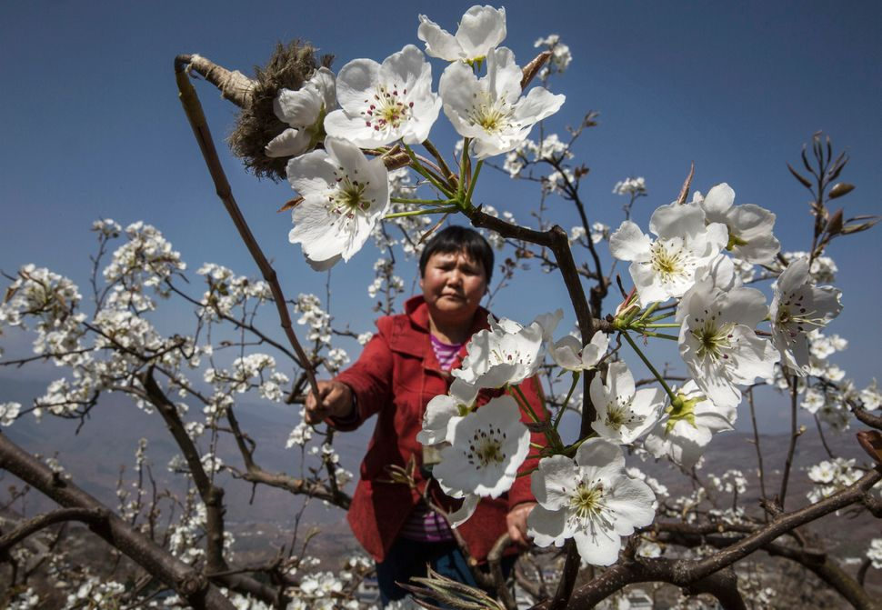
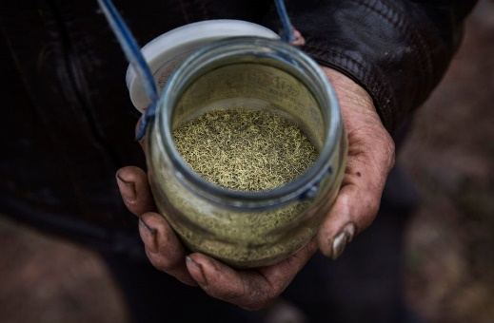
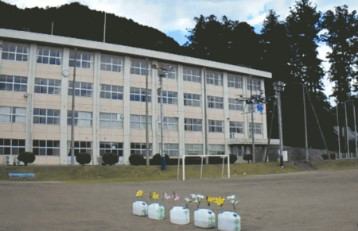
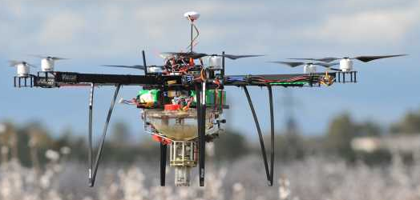
A World Without Pollinators
In the absence of pollinators, these crops would require a lot more labor or new technology
Hanyuan county, Sichuan province, China:
Known as the world’s pear capital, but pesticide use has drastically reduced the local bee population, forcing farm workers to pollinate by hand¹
Pollinating drones:
Engineers have created and tested drone designs to deliver collected pollen to female flowers^{2,3}
¹Casey Williams (2016) “These photos capture the startling effect of shrinking bee populations” Huffington Post, Verlzon Media [Internet]. Available at: https://www.huffpost.com/entry/humans-bees-china_n_570404b3e4b083f5c6092ba9
[top images] Frayer, Kevin. Getty Images. From above article.
² [gif] Yang, Xi & Eijiro Miyako (2020) Soap Bubble Pollination. iScience 23(6): 101188.
³ [bottom image] Herrick, Christina (2019) “Bee Free! How Growers can pollinate with drones” Growing Produce [internet]. Available at: https://www.growingproduce.com/fruits/bee-free-how-growers-can-pollinate-with-drones/
Notes:
And we are starting to figure out what a world may look like without pollinators. In China, heavy pesticide use has drastically reduced the local bee population and now farmers have to hand pollinate their own crops, shown here with a pot of collected anthers with pollen and a feather stick applicator. This solution requires heavy labor, both in collecting anthers and applying pollen to each individual flower.
Engineers are also developing robots and drones that can deliver pollen to crop plants. Here is a video showing a drone using bubbles to deliver pollen from a study published last year showing this required less collected pollen to ensure pollination. Other methods include feathery features attached to the drones to carry and apply pollen, and I believe I’ve heard of drones just dispersing dried pollen above crop fields. In fact, in my old lab a farmer involved in an almond research experiment was deploying drones to increase almond pollination, and at the bottom is an image of a drone used for almond pollination in California, which is experiencing similar pollination issues to what has happened in China.

Slide 21
Conflict of Interests
hhhh
^{hhhhh}
Notes:
So why should we care? One reason is because pollination is important for the production of many food crops. Although many staple crops providing many calories like wheat, rice, and corn are wind pollinated, 35% of the world’s food crop production is reliant on animal pollination, including a lot of the food that many believe make diets more enjoyable like fruits, vegetables, some nuts, and other crops. That equates to about 1/3 bites of food you eat are reliant on animal pollination.

